Slide 1
Filters 1

Slide 2
What is filtering?
Filtering is a technique for modifying or enhancing an image.
For example, you can filter an image to emphasize certain features or remove other features.
Image processing operations implemented with filtering include smoothing, sharpening, and edge enhancement.

Slide 3
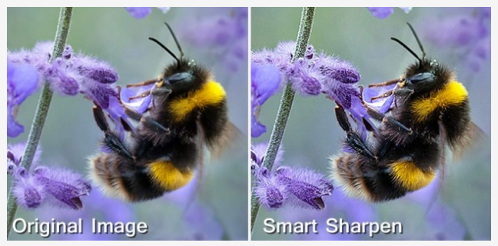
Examples (sharpening)

Slide 4
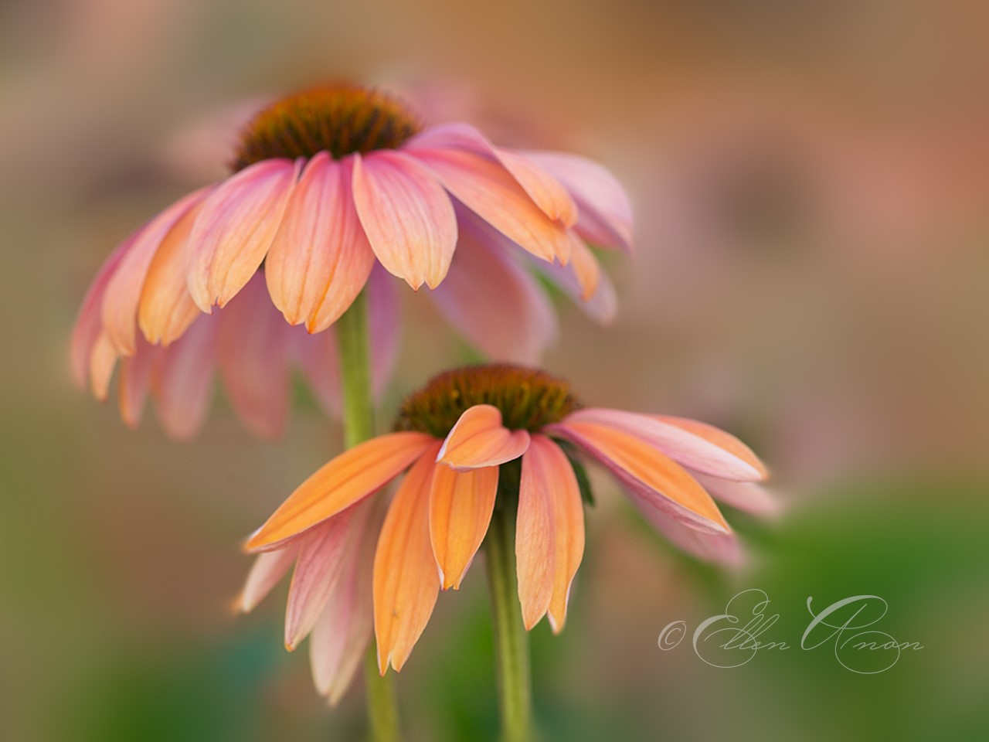
Examples (blurring)

Slide 5
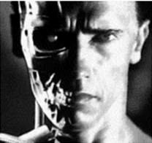
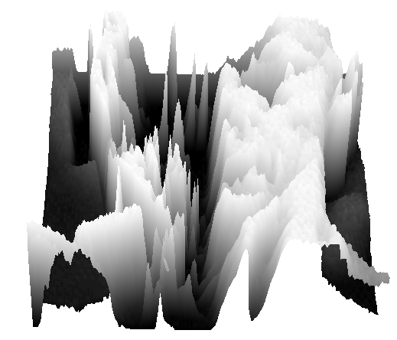
Images as functions
We can think of a (grayscale) image as a function, where
f (x,y) gives the intensity at position (x,y)
A digital image is a discrete (sampled, quantized) version of this function

Slide 6
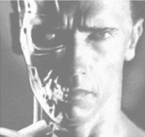
Image transformations
As with any function, we can apply operators to an image
g (x,y) = f (x,y) + 20
g (x,y) = f (-x,y)

Slide 7
Kernel Transformations
Replace each pixel by a linear combination of its neighbors
The prescription for the linear combination is called the “kernel” (or “mask”, “filter”)
Involves sliding a kernel (filter) across an image.
A mask should always be in odd number, because other wise you cannot find the mid of the mask.
10
5
3
0
0
0
4
6
1
0
0.5
0
8
1
1
8
0
1
0.5
Local image data
kernel
Modified image data
Source: L. Zhang

Slide 8
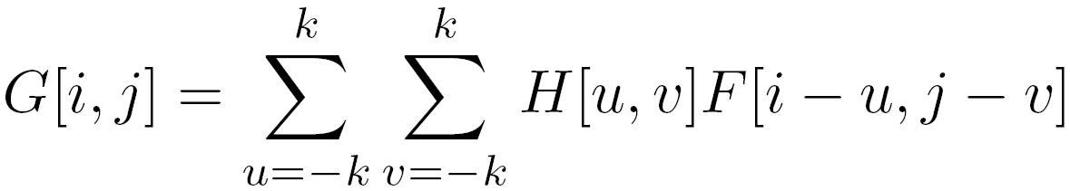
Calculation
Assume original image is H. Filter is F. G is the resultant image. Each resultant pixel in G is calculated by:

Slide 9
How to do it
In order to perform a filter on an image, following steps should be taken.
Slide the mask onto the image.
Multiply the corresponding elements and then add them
Repeat this procedure until all values of the image have been calculated.

Slide 10
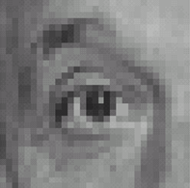
Linear filters: examples
*
0
0
0
=
0
1
0
0
0
0
Original
Identical image
Source: D. Lowe

Slide 11
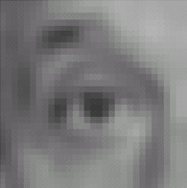

Linear filters: examples
*
1
1
1
=
1
1
1
1
1
1
Original
Blur (with a mean filter)
Source: D. Lowe

Slide 12
We just did blurring with a 3x3 mask.
Consider a 5x5 mask:
What would the effect on blurring be?
What would the values of the mask need to be?
It is also possible to have masks that are 7x7, 9x9, etc… Try it out!
Source: D. Lowe

Slide 13
Python Implementation
img = cv2.imread('images/lena.jpg') img = cv2.cvtColor(img, cv2.COLOR_BGR2RGB) #kernel = np.ones((5,5),np.float32)/25 or kernel = np.array([[1, 1, 1], [1, 1, 1], [1, 1, 1]]) dst = cv2.filter2D(img,-1,kernel)
Try implementing different levels of blurring!

Slide 14
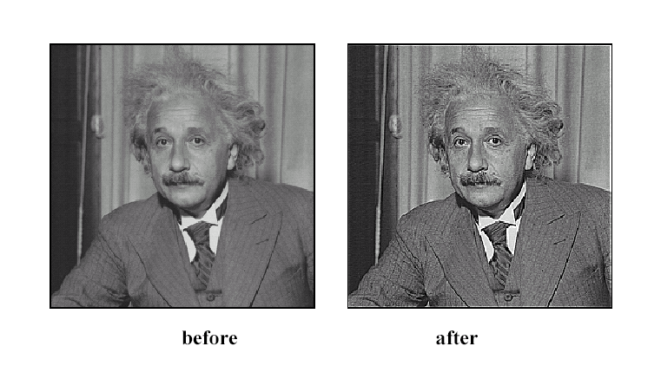
High-pass filters - Sharpening
Source: D. Lowe

Slide 15

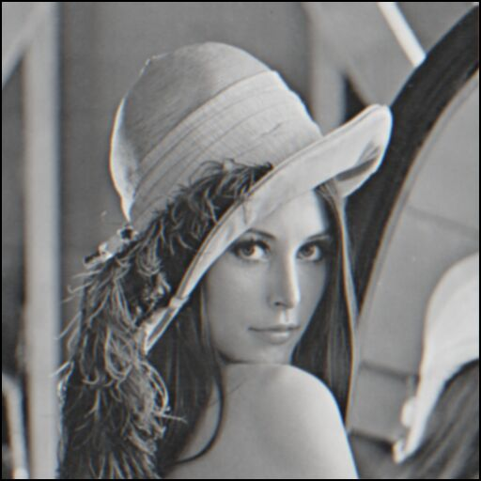
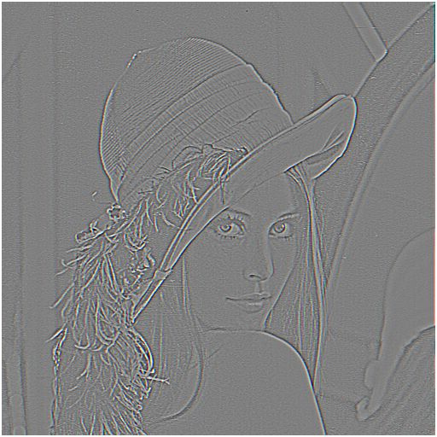

Sharpening
What does blurring take away?
–
=
original
smoothed (5x5)
detail
Let’s add it back:
+ α
=
original
detail
sharpened
Source: S. Lazebnik

Slide 16
Questions?

